Slide 1
Beyond the Batter’s Box
Analyzing the Winners and Losers of America’s Pastime

Slide 2
Overview
In this presentation, we will be analyzing a deep pool of data focused on Major League Baseball teams.
We have created a machine learning model that is capable of predicting performance as a function of salary - specifically in regards to:
Batting: Hits, Average, Runs, Home Runs, Extra Base Hits, Strike Outs, Walks
Pitching: Strike Outs, Outs, FIP, BAA, Innings, and ERA

Slide 3
Why Baseball?
This topic was selected not just for our love of baseball, but because America’s Pastime has been around for over 120 years, and has an immense volume of data available for a machine learning model to incorporate. Between fans of the game, historians, front-office types and gamblers, there will always be people interested in this data and the answers it holds.
Some teams like the New York Yankees have a strong legacy of both spending money and winning championships. Other teams like the Tampa Bay Rays have had significant success (still chasing their championship), and have barely spent anything. We want to find out which strategy makes the most sense, and we’re going to use machine learning to do it.

Slide 4
Data Source
We’re leveraging an amazing open-source data center for Major League Baseball, the Lahman Database, which can be found here: http://www.seanlahman.com/baseball-archive/statistics/
Each zip file contains CSV documents that cover topics of interest in baseball. The data goes back all the way to 1871, so we can have confidence in the model’s depth of information.

Slide 5
Example Questions
A good example of how we can look into the why behind salary information its role in successful teams. For example the 2020 Tampa Bay Rays was the lowest paid team in Major League Baseball. They ended up being American League East Division champions, then won the entire American League and then we to the 2020 World Series. Is team salary a bad predictor of team success?
Clayton Kershaw is one of the best pitchers in baseball and had a major role in the LA Dodgers’ win over the Rays in the 2020 World Series. He’s also the highest paid pitcher in baseball. Do his statistics justify his salary, and did they have an impact on the World Series win? Or was he simply on the best offensive team?

Slide 6
Data Exploration
Through pre-processing the data, we chose supervised learning via a Random Forest Model. The Random Forest Model uses classification to predict based on our salary target and our features which are year, team, stats (like strikeouts), and birth year. By pairing down the data, through combining and cleaning the csv files, it really dialed in to the details of what we wanted to measure. Basing the main measures on Mike Trout's core statistics(SO,AB,R,H,HR,G,R and RBIs), we used his metrics as a baseline to look for when deciding our final goal. Also, including the ‘awardID’, which shows which award each player won, and ‘lgID’, which shows the league in to see if that had any impact. Then the Random Forest Model interprets this information and gives an accuracy score based on what is the most impactful in deciding the salary of a player. The confusion matrix and list of importances each show the logic behind what determines how much to pay each player.

Slide 7
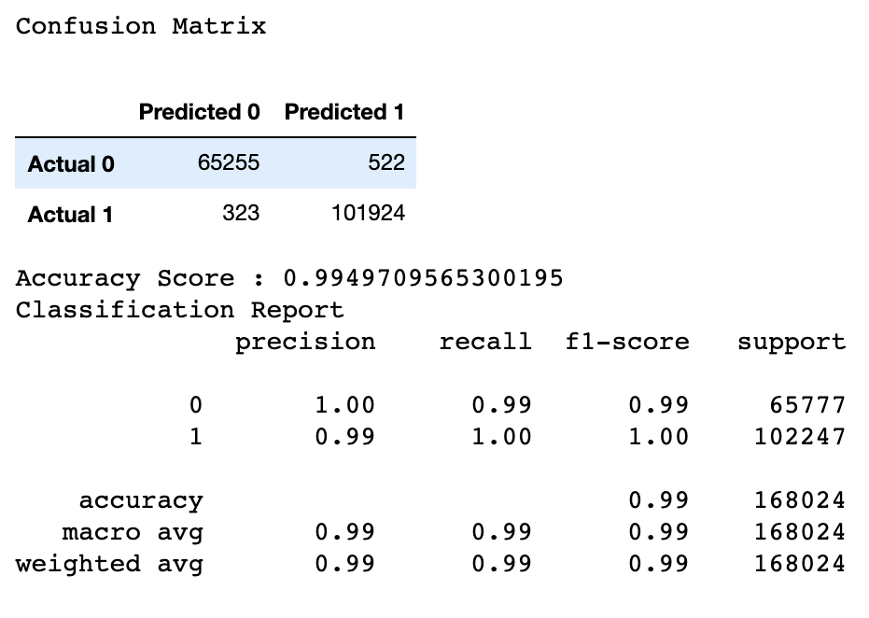
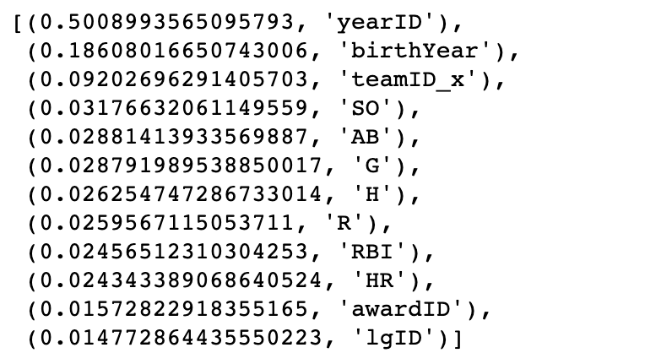
Data Exploration

Slide 8
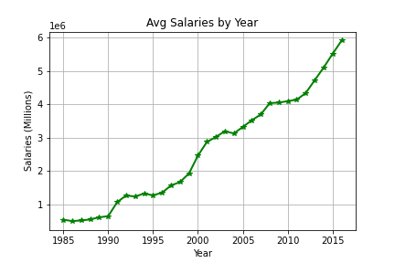
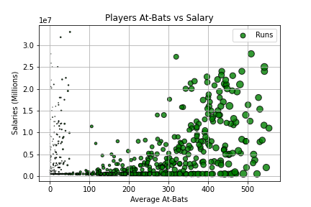
Analysis

Slide 9
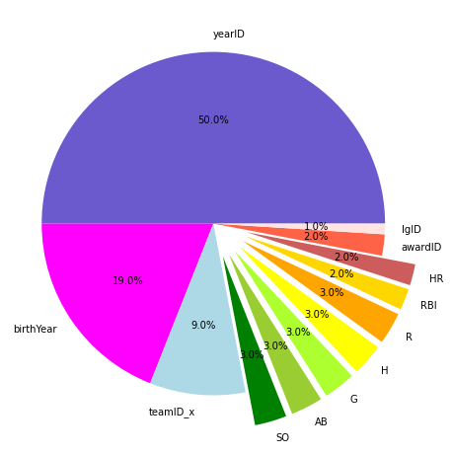
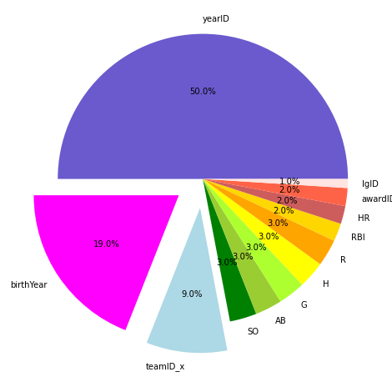
Analysis

Slide 10
Tableau Dashboard
LINK TO DASHBOARD & INSTRUCTIONS WILL GO HERE

